Slide 1

AI Bootcamp

Slide 2
What is AI Bootcamp
AI bootcamp program is an 8 week intensive course on data science and AI.
It is designed to provide all the training and resources that participants need to effectively transition to and develop a career in data science.
Throughout the program, coaches will lead participants through the foundational concepts of data science and AI, giving them an overview of the field, as well as developing practical skills for solving industry-specific problems.

Slide 3
What is AI Bootcamp
Lectures will be held at FAST office Each Monday 6:30 – 9:30 pm Each Wednesday 6:30 – 9:30 pm Each Saturday 10:30 am – 1:30 pm
The Lectures will generally have the following form: 50 min lecture and warm up exercises, 10 min break, another 50 min lecture and warm up exercises, another 10 min break, 1 hour coding exercises and kahoot!
There will also be home exercises home exercises will require 5-9 hours of commitment

Slide 4
AI Bootcamp - Syllabus

Slide 5
AI Bootcamp – Guest Lectures

Slide 6
AI Bootcamp – Projects
Project 1: NLP in material science discovery
Project 2: GAN for Megerian Carpet
Project 3: Armenian Handwritten Letters
Project 4: ???
Project 5: ???
Project 6: ???
Project 7: ???
The ??? Projects will be decided by students. In case you want to continue your projects after Bootcamp ends, you are free to come to FAST office and “use” data science team mentorship.

Slide 7
AI Bootcamp – Workshops
3 workshops
Workshop on GANs (Generative adversarial Networks)
Workshop on Reinforcement Learning
Workshop on Scientific Entrepreneurship

Slide 8
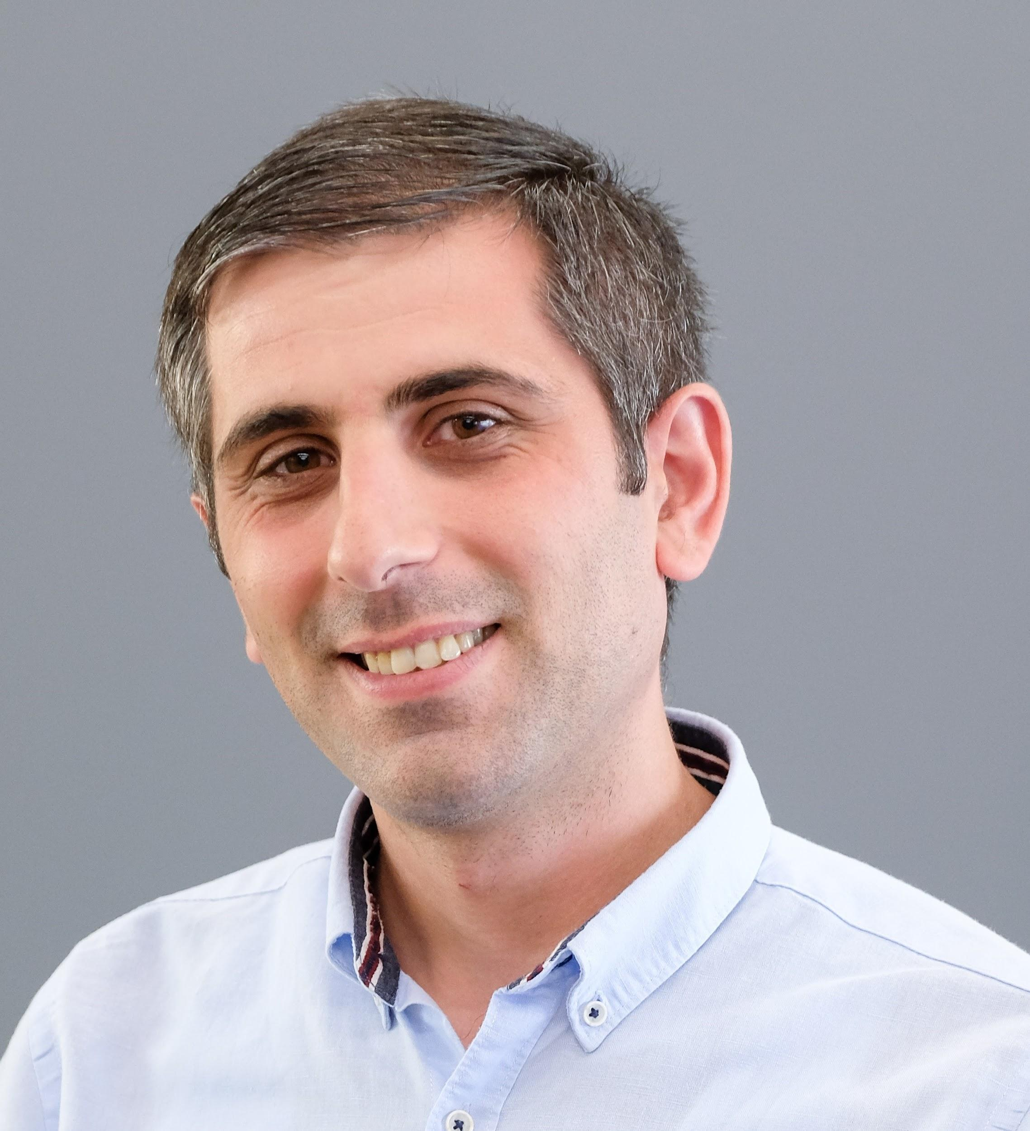
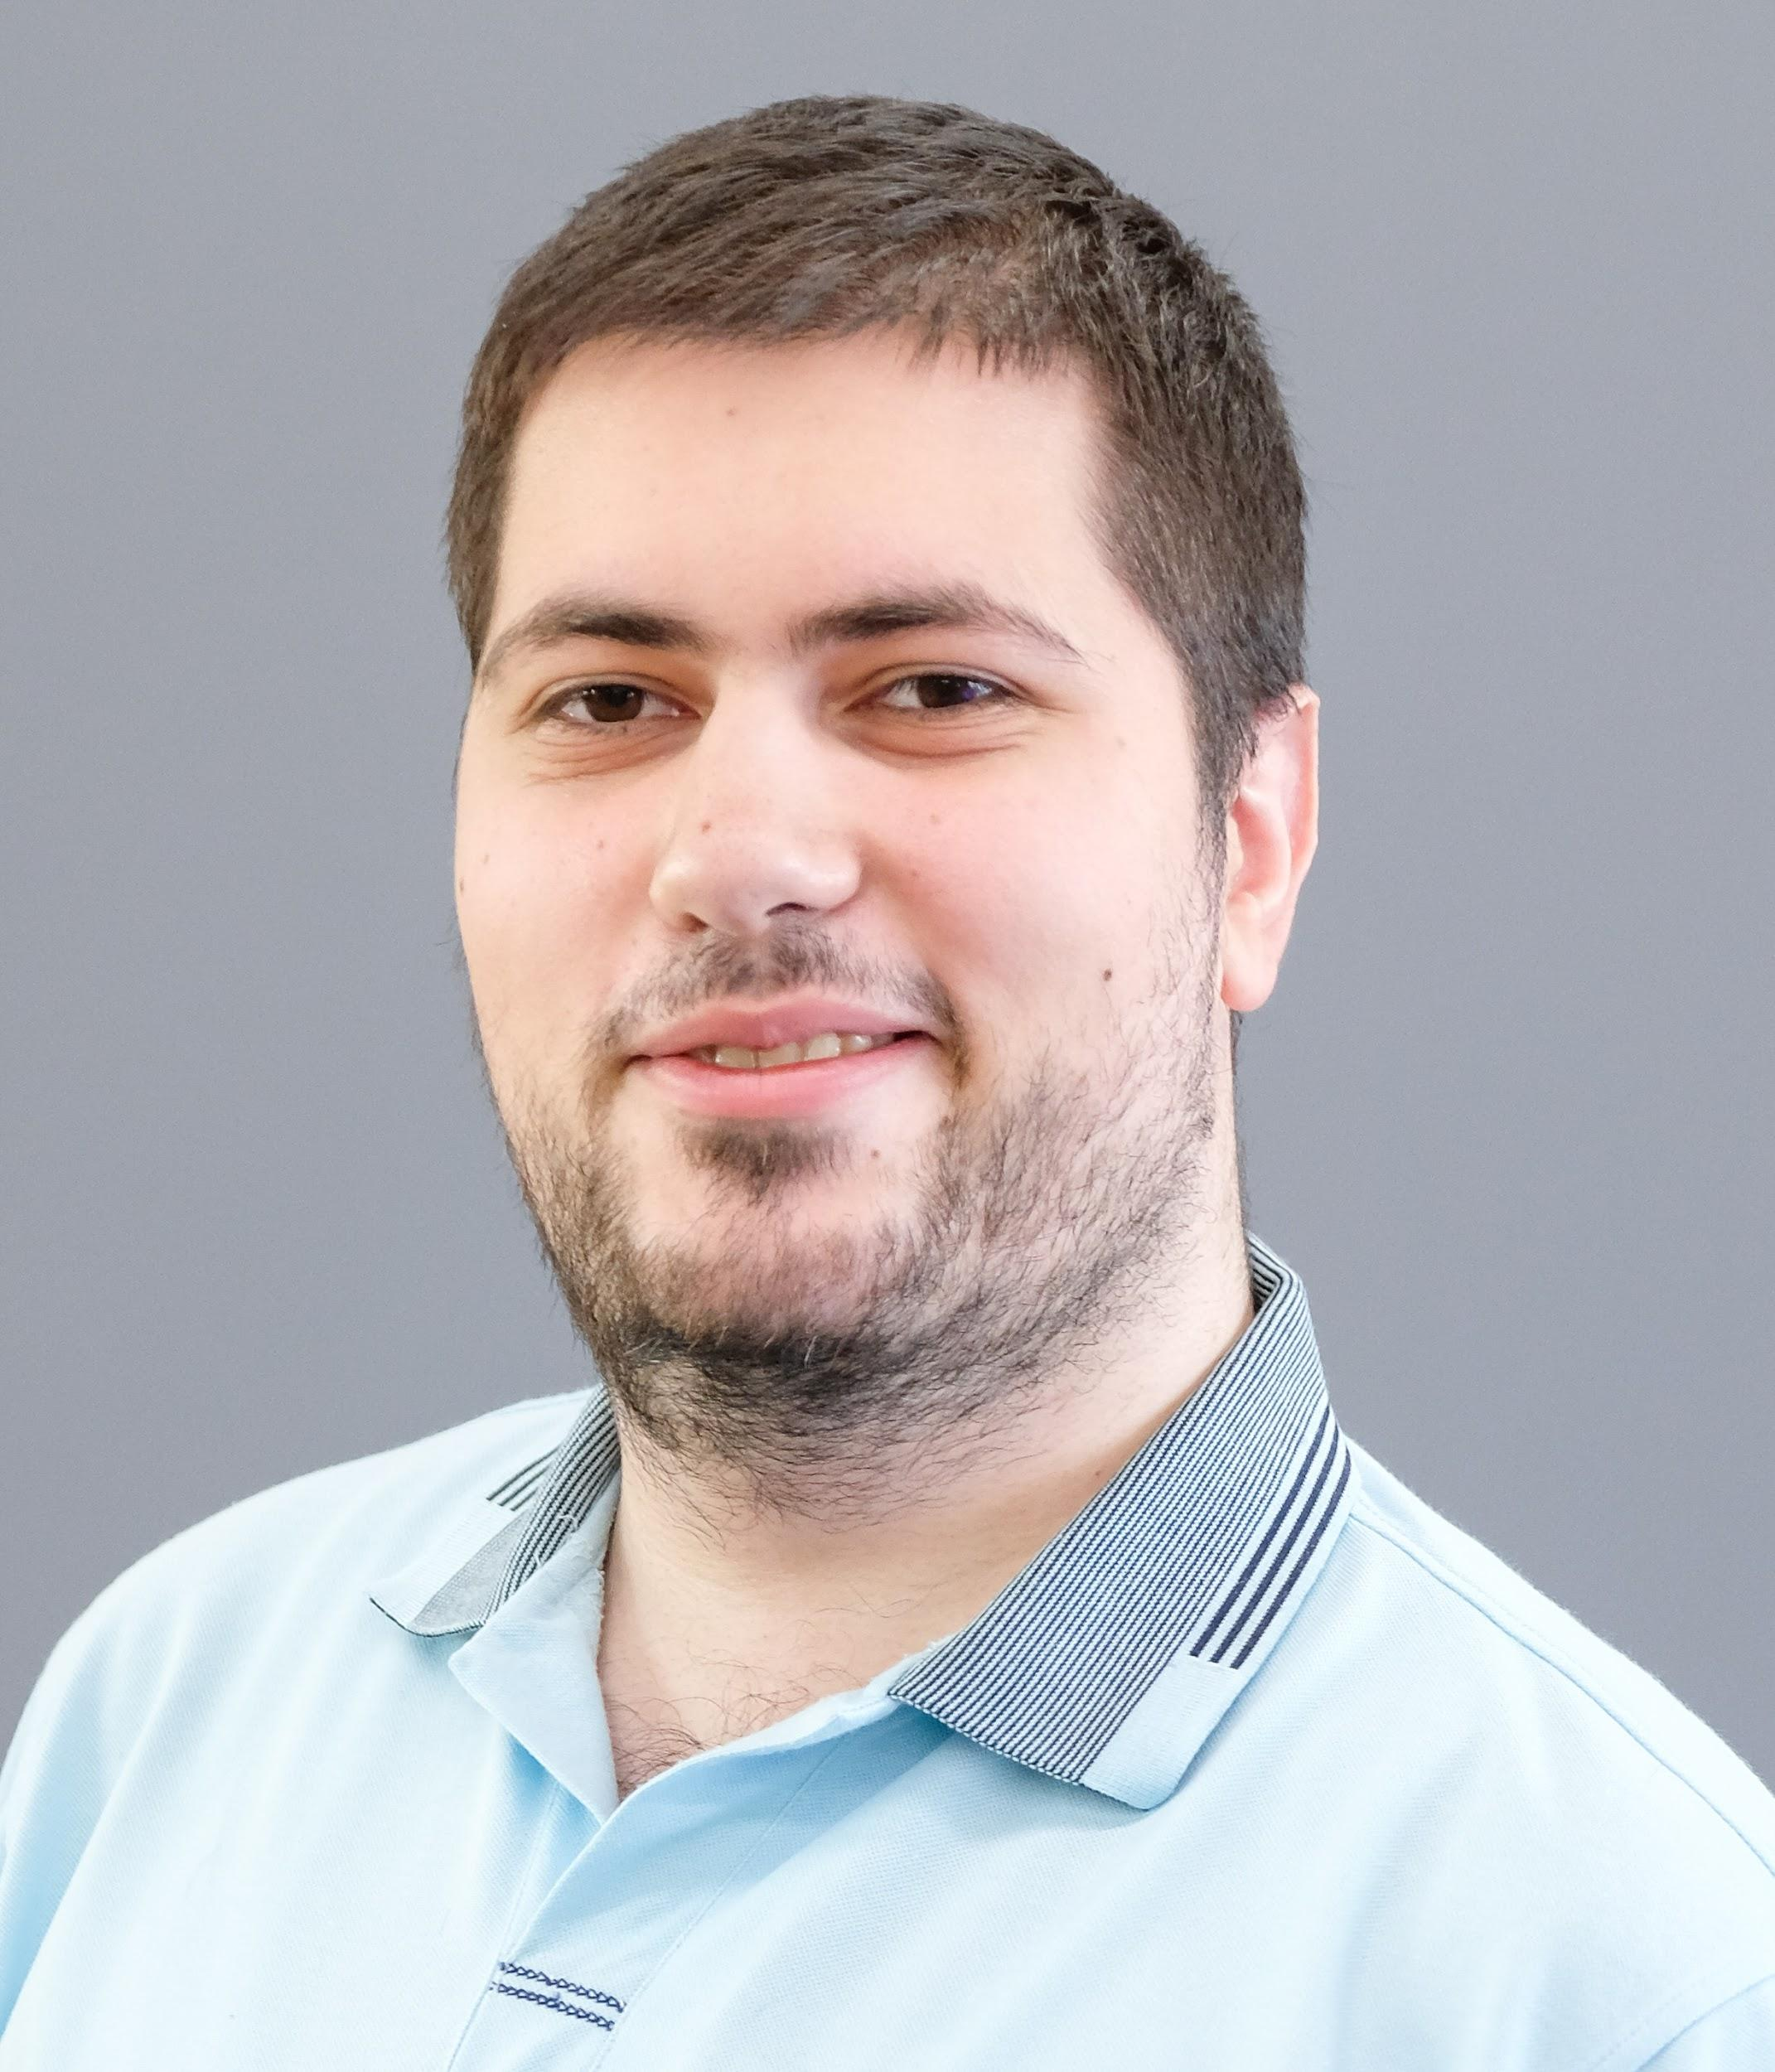
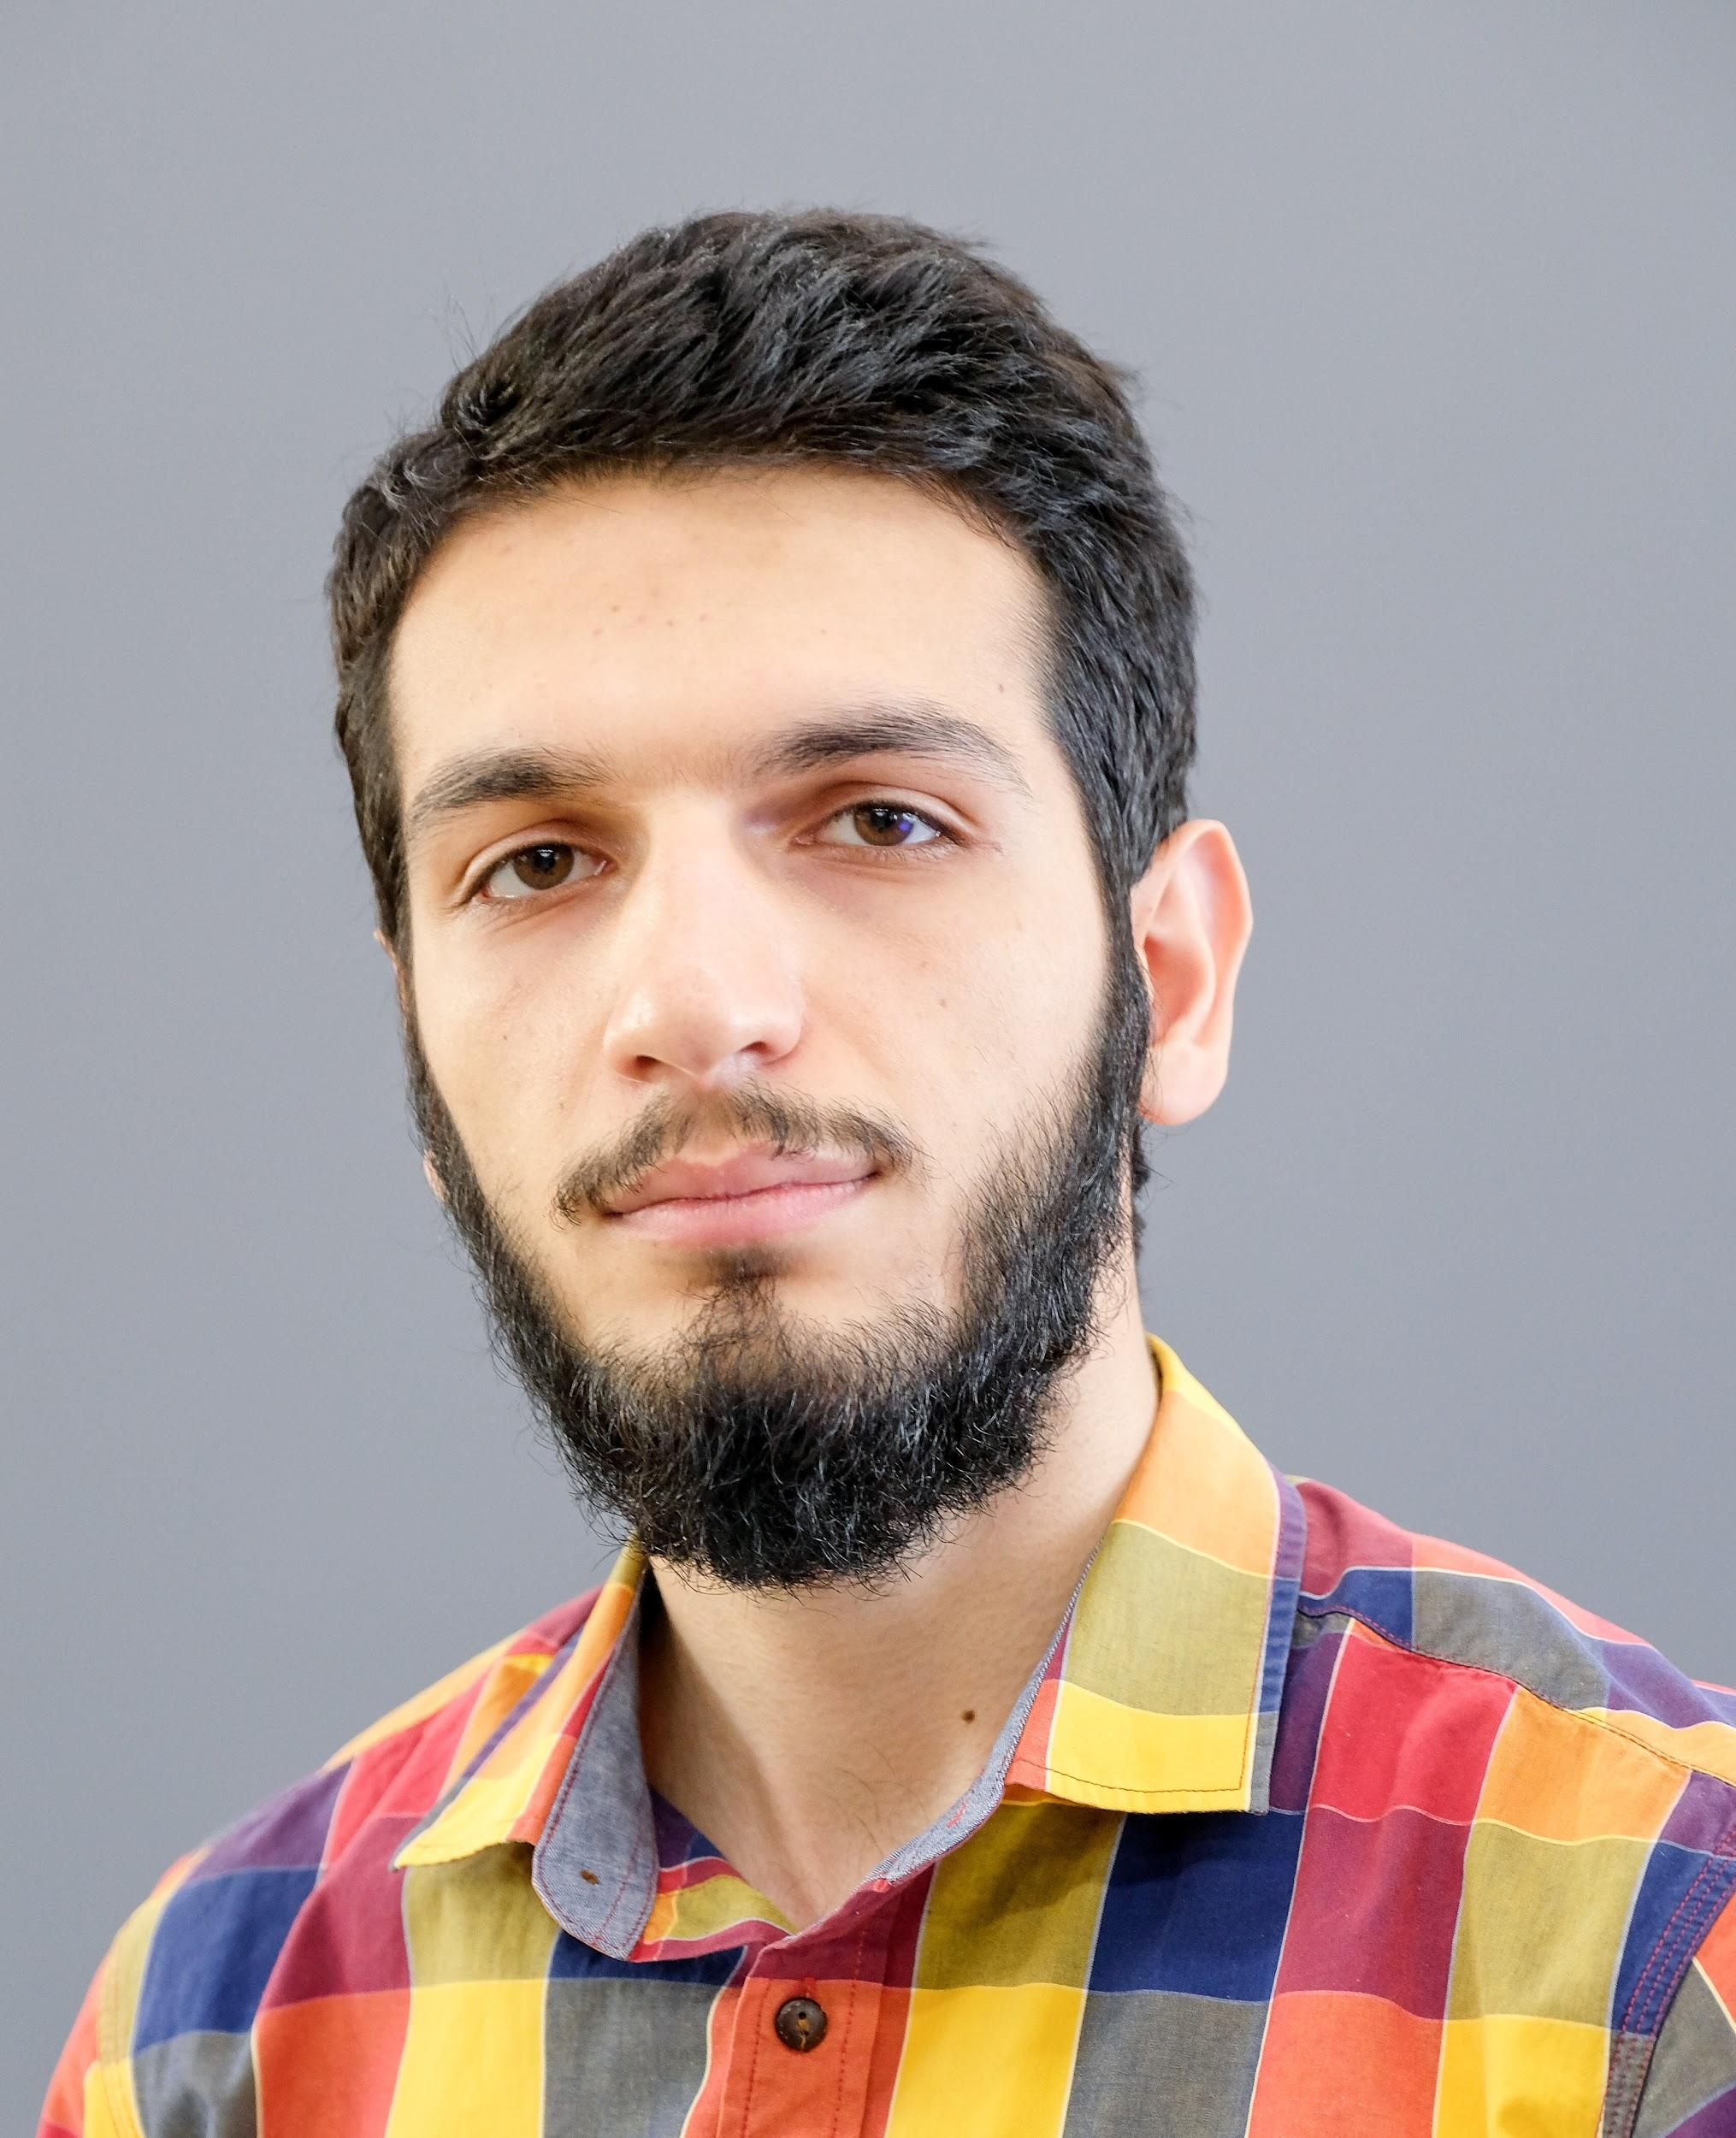
Speakers
Dr. Davit Ghazaryan
Senior Research Associate (Data Scientist), ASCENT
Davit Ghazaryan is a Senior Research Associate (Data Scientist) at ASCENT. He holds a PhD in technical sciences and has a strong background in Machine Learning and other related areas. He is also familiar with recommender systems and has a good understanding of Control and Automation systems, Operation Research, Numerical Methods and Decision-Making.
Current Fields of Interest: Machine Learning, Generative algorithms, and Optical Character Recognition.
Vardan Harutyunyan
Research Associate (Data Scientist), ASCENT
Vardan Harutyunyan is a Research Associate (Data Scientist) at ASCENT. With a background in both academic research and industry, Vardan has experience in applying ML and statistical methods to the social sciences, biostatistics, credit scoring, and time series analysis.
Current Fields of Interest: Bayesian Modeling, Multi-Agent Reinforcement Learning, and Information Theory.
Mher Matevosyan
Data Science Expert, FAST
Mher Matevosyan is a Data Science Expert at FAST. He has experience in industry applications as well as academic research. He has worked on customer churn analysis, machine learning models for loan default prediction, NLP on information extraction, Deep Learning algorithms application in Computer Vision and IoT.
Current Fields of Interest: Deep Learning, Reinforcement Learning, Generative and Variational Inference Models.

Slide 9
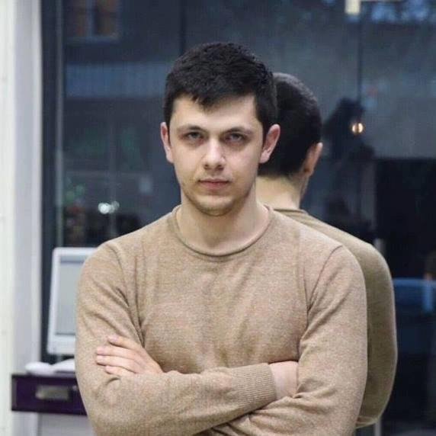
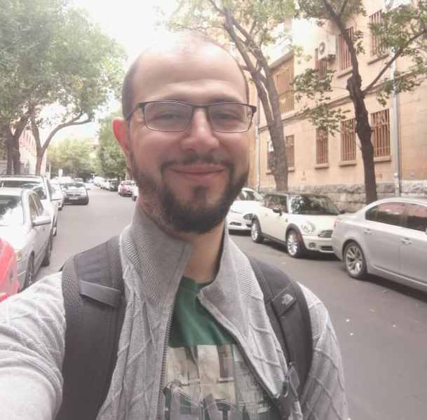
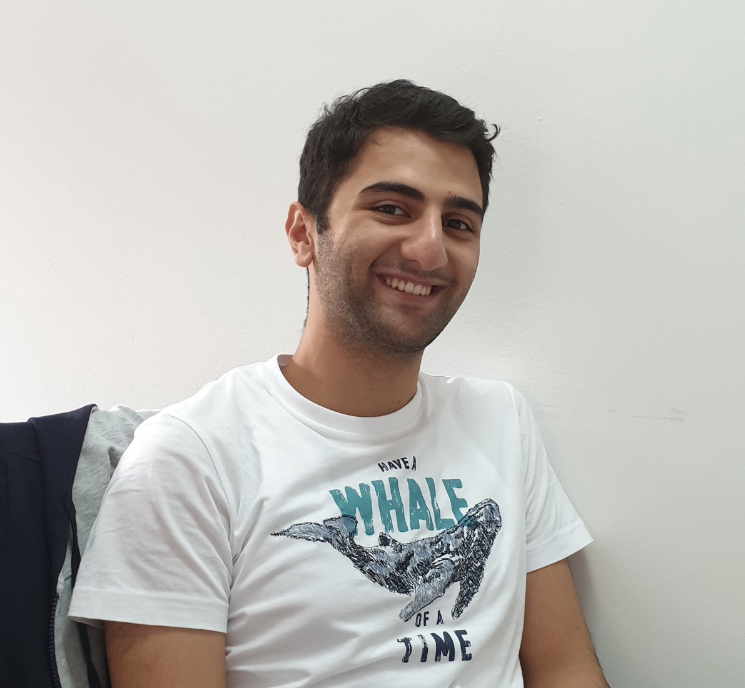
Speakers
Khoren Petrosyan Machine Learning Engineer, SoftConstruct
Khoren leads the Machine Learning Team at SoftConstruct, working on customer data in churn prediction, computer vision tasks like object detection in highly unbalanced datasets from video feed, developing a voice based chat bot called hoory. Khoren also taught Machine Learning course at YSU in Data Science for Business course. Main research interests are Deep Learning model interpretation, Reinforcement Learning, Adversarial Examples, Model Complexity Estimation/Regularization.
Nerses Alikhanyan Machine Learning Specialist, Webb Fountaine
Nerses Alikhanyan is a Machine Learning Specialist at Webb Fountaine.
During his career he has been working on industrial applications as well as done research for a wide variety of ML related fields. He has used machine learning approaches in projects including risk analysis, fraud detection, optical character recognition and NLP for named entity recognition tasks. Current Fields of Interest: Deep Learning, OCR, NLP.
Vahan Arsenyan Machine Learning Specialist, Webb Fountaine
Vahan Arsenyan is currently working at Webb Fontaine as a Machine Learning Specialist mainly on projects such as fraud detection, text classification and search engines. Having his background in Information Security and Software Engineering he has done research on methods of trainings of Neural Networks on encrypted data. Current Fields of Interest: Bayesian statistics and Kernel methods

Slide 10
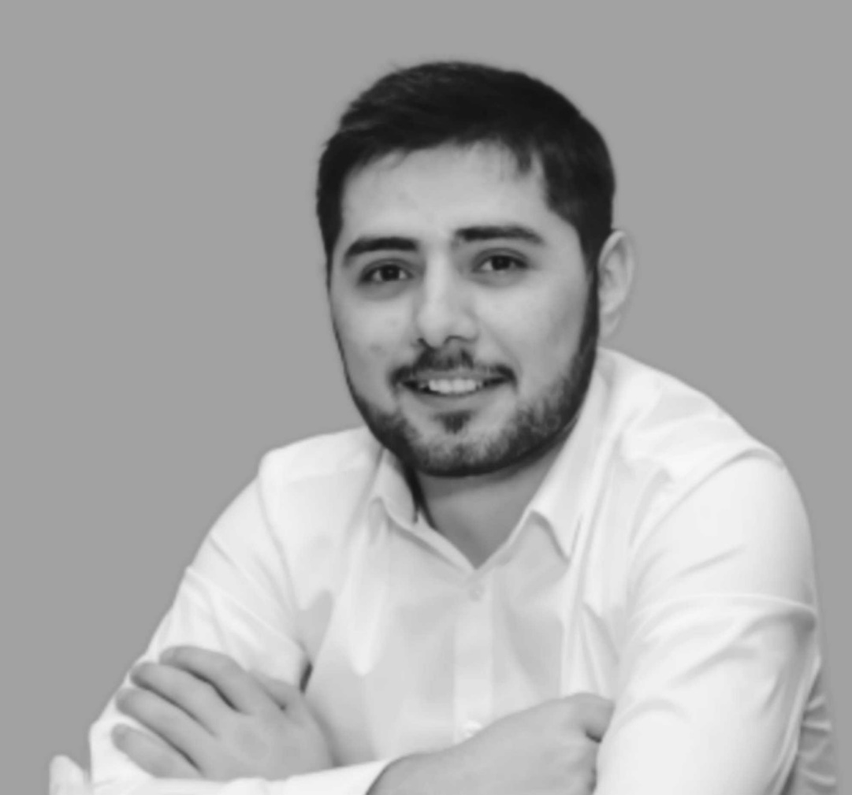
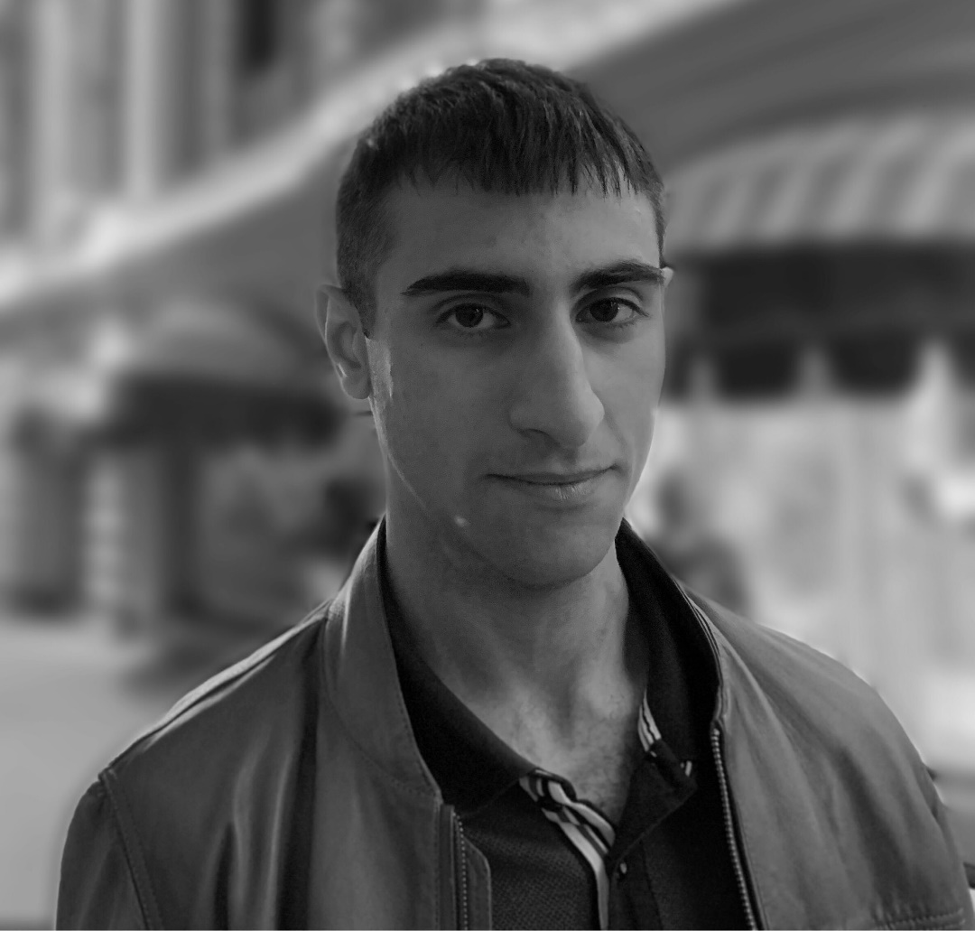
Speakers
Hazarapet Tunanyan
Data Scientist, PicsArt
He holds a M.S. degree in Computer Science and is working on computer vision applications and deals with visual data.
Main fields are classification, semantic segmentation, object detection and instance segmentation, which are designed to be solved with deep learning methods.
He also has a couple of years experience of Software Engineering and Software Design.
Current Fields of Interest: Deep Learning, Object Detection, Semantic and Instance Segmentation
Shant Navasardyan
Data Scientist, PicsArt
Shant Navasardyan is a Data Scientist at Picsart. He has experience in Computer Vision (CV) and currently teaches CV at Yerevan State University. He has worked on object detection, semantic segmentation and tracking, image matting, image inpainting, style transfer and on pruning of deep neural networks.
Current Fields of Interest: Computer Vision, Deep Learning.

Slide 11
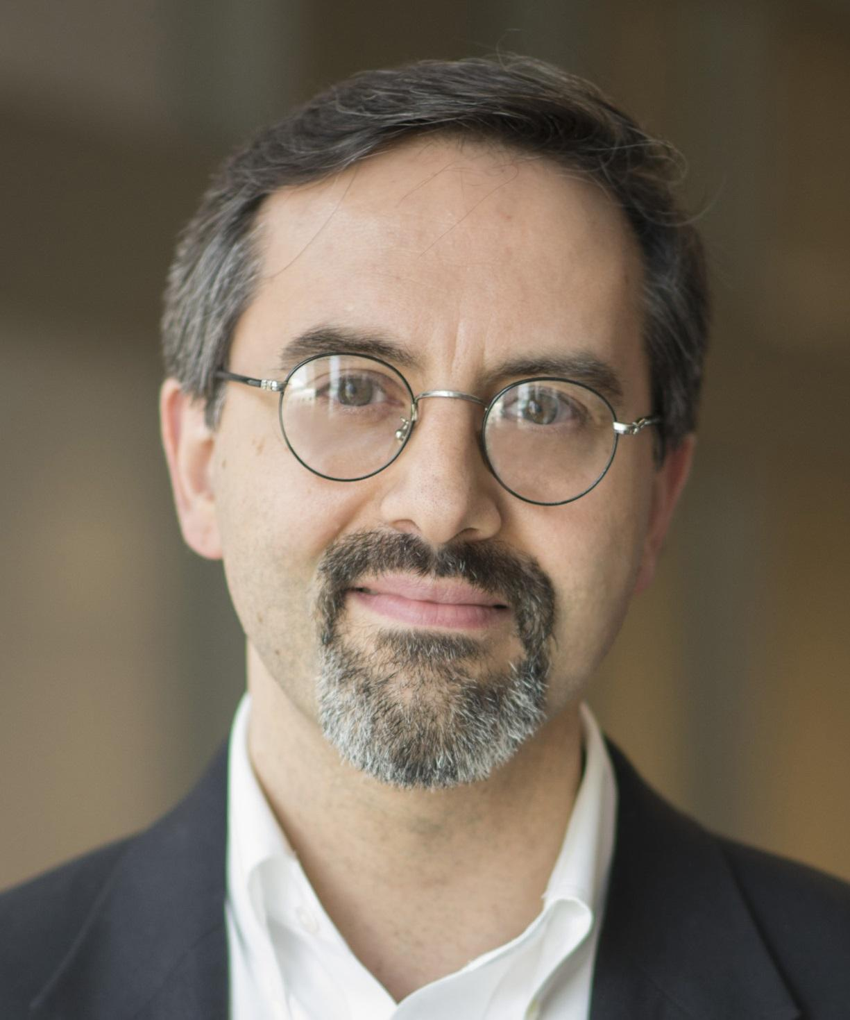
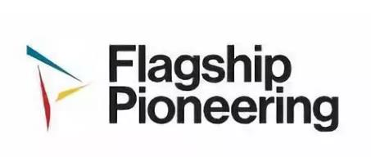

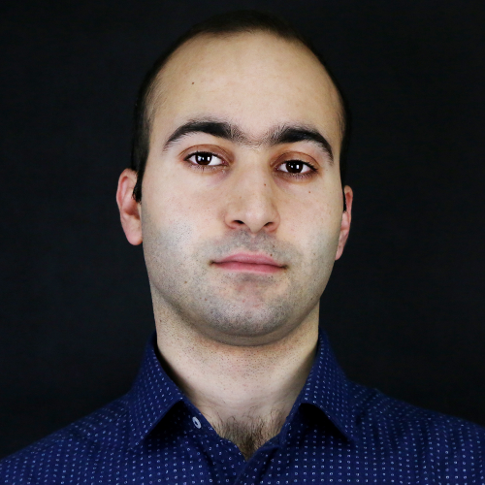
Speakers
Dr. Aram Adourian
Senior Science Advisor, Flagship Pioneering
Dr. Aram Adourian is a Senior Science Advisor at Flagship Pioneering, a Boston-area firm that conceives, creates, resources, and develops life sciences companies to transform human health and sustainability.
Dr. Adourian most recently served as Chief Scientific Officer at BG Medicine, a company created in Flagship Labs that develops diagnostic solutions to aid in the clinical management of chronic diseases. Dr. Adourian's career in the life sciences spans more than two decades, with roles in basic and applied research, and product development and commercialization. Dr. Adourian earned his Ph.D. at Harvard University in physics, and studied biophysics and mathematics at Cornell University.
Dr. Vahe Tshitoyan
Machine Learning Engineer, Google ATAP
Vahe is a scientist and innovator working at the intersection of physical sciences and machine learning. He currently works as a machine learning engineer at Google ATAP. He holds a PhD in physics from the University of Cambridge, with past research experience at Lawrence Berkeley National Laboratory (NLP for materials science), IBM Research (spintronics), ETH Zurich (quantum heterostructures) and Yerevan State University (cosmology).
In 2018, Vahe was named amongst one of the 30 most influential Europeans under the age of 30 in science and healthcare by Forbes Magazine. He is a recipient of numerous national and international awards, including Honorable Mention at the 37th International Physics Olympiad (2006), Educational Award of the President of Armenia in IT (2006 and 2010) and Winton Award for the Physics of Sustainability (2012) to name a few.

Slide 12



THANK YOU
fast.foundation

